Slide 1
AMAZON CLOUD SALES DEMONSTRATION ENVIRONMENT
Anne Markis
Nick Quaranto
Jen Goldbach
Chris White
Rob Jones
Notes:
rob

Slide 2
PROJECT CONTEXT
Paychex sales reps show potential clients apps
Current setup process is complex
Data integration hard to demonstrate
Customizing data is a laborious process
Notes:
Paychex sales representatives give live demonstrations of various Human Resources and Payroll products to potential clients.
Sales reps collaborate with system administrators to set up demos tailored to individual potential customers.
The sales reps are not able to handle the technical load associated to the current sales demonstration process so Paychex was looking for a simple and effective solution.
3,000 sales tablets accessing this information from the cloud.
Another issue with the current process is data integration between the products in these demonstrations is hard to demonstrate because the demos are run locally on the sales representatives tablets. This is a major issue when attempting to sell a software suite where one of the key features is shared data.
Also customizing the data for each individual customer is a very time consuming process but it is a necessary step for an effective sales demo.

Slide 3
PROJECT SCOPE
In
Salespeople can configure demo environments
Select apps, industry, custom data
Simulation of Paychex Applications
Out
Real Paychex Applications, Databases
Citrix Integration
Polished Sales Demonstration
Notes:
When determining the scope of this project we had to keep in mind that we were not developing a production application. Paychex just wanted us to prove that this concept was feasible.
They also wanted us to provide them an application that would help them estimate the cost of running the application on the cloud as opposed to using in house servers.
The project scope has changed several times since the beginning of the project.
The main reasons for these scope changes were the over head associated to the requirements that were removed and focusing on the requirements that Paychex determined were the most important.
If you look at the list the requirements that were removed are not mission critical to our initial task which was to create a demonstration platform for the Paychex applications.
That mainly applies to integrating real Paychex applications and Citrix integration, which if you are not familiar with it is a desktop application remote presentation platform.
The time associated to learning these applications and using them effectively would not fit into this project. So they were removed.

Slide 4
SOLUTION
Fast setup of apps to demo using Amazon EC2
Easy data customization for clients
Monitoring of EC2 instances
Real-time data integration across apps
Notes:
anne

Slide 5


AMAZON CLOUD
AMI
Notes:
nick

Slide 6
AMAZON CLOUD
EC2 INSTANCE
AMI
Notes:
nick

Slide 7
AMAZON CLOUD
EC2 INSTANCE
Payroll
Time & Labor
AMI
Notes:
nick

Slide 8
AMAZON CLOUD
EC2 INSTANCE
Payroll
Construction
Time & Labor
AMI
Notes:
nick

Slide 9
AMAZON CLOUD
EC2 INSTANCE
Payroll
Construction
Time & Labor
AMI
Notes:
nick

Slide 10
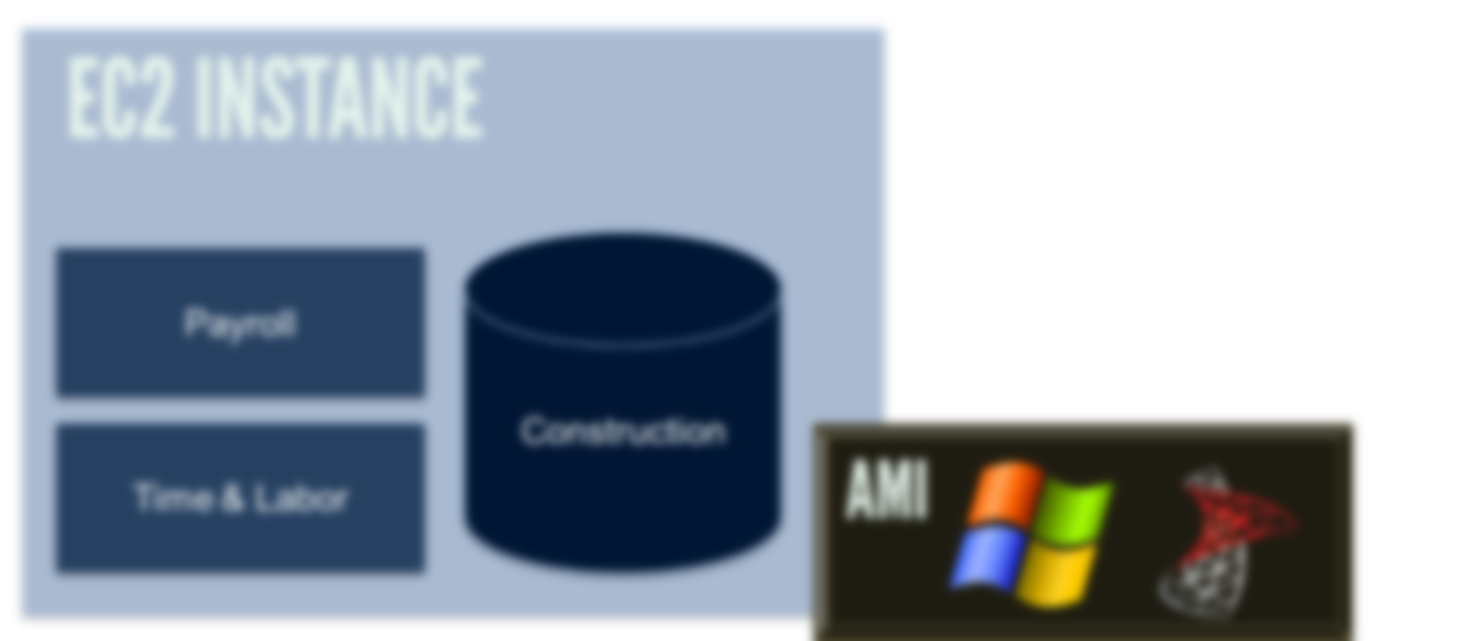
AMAZON CLOUD
DEMO FOR PIZZA HUT
Notes:
nick

Slide 11
AMAZON CLOUD
DEMO FOR PIZZA HUT
Notes:
nick

Slide 12
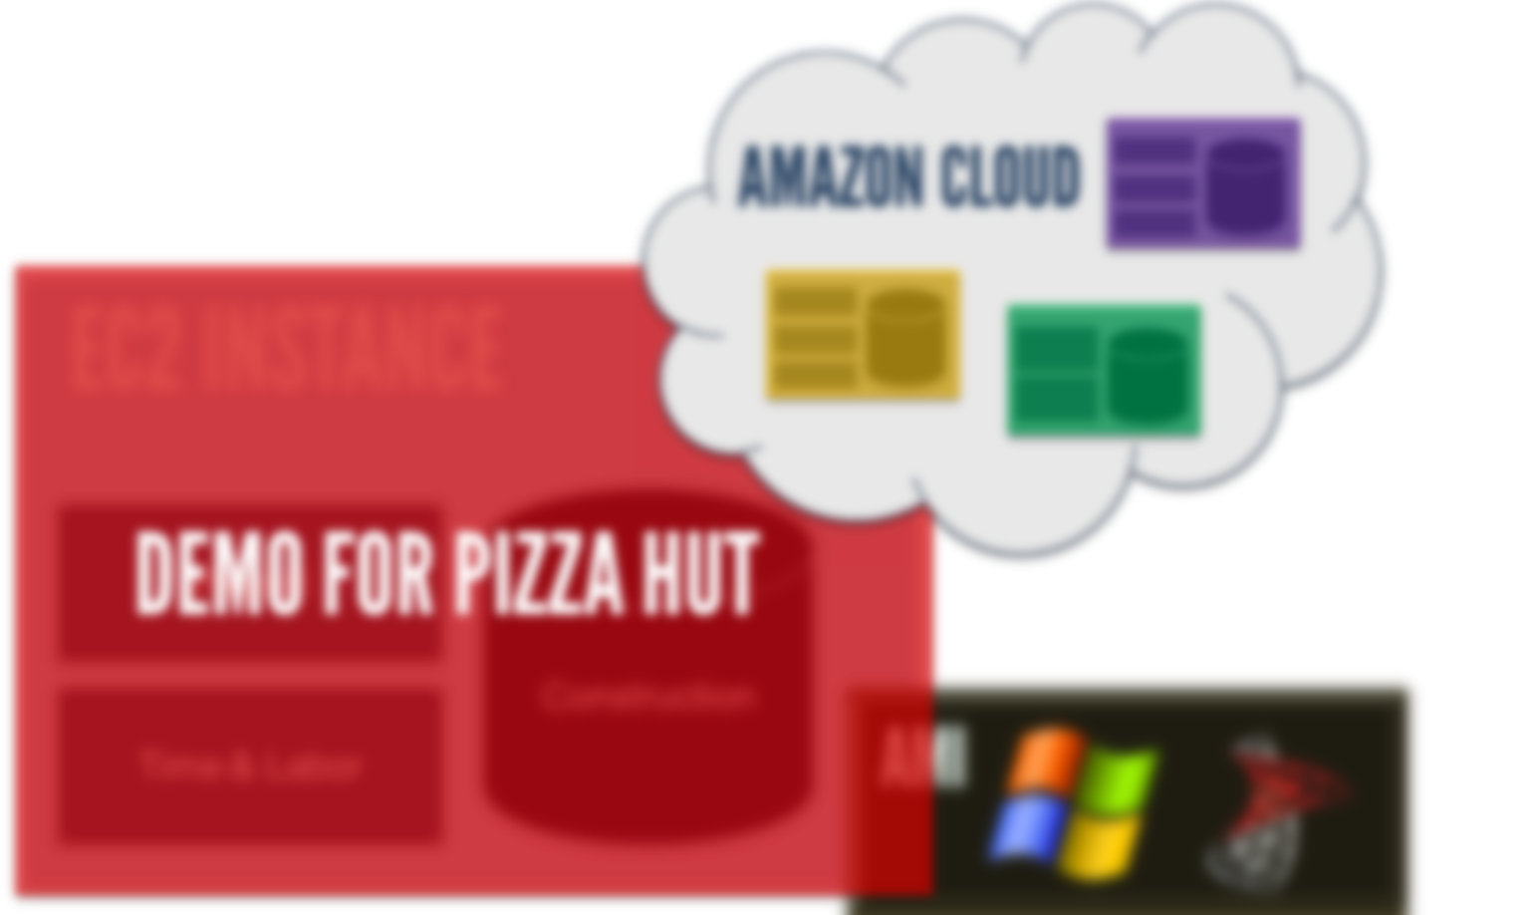
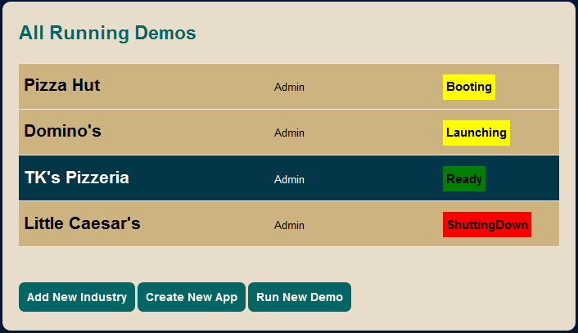
Notes:
nick

Slide 13
ARCHITECTURE
Web Application (ASP.NET MVC 2)
Setup and customize demos
EC2 instance management
Windows Services Console Applications
Spawn EC2 instances
Periodically check for altered data
Data generation
Notes:
anne

Slide 14
TRADEOFFS
Web app vs desktop app
Easier to access, maintain, deploy
Closest simulation to real use
One vs many instances per demo
One instance/AMI, simple to get started
Advised against going with many
Notes:
nick

Slide 15
DEMO WORKFLOW
BOOT
Boot EC2 Instance
Single Sign On
Demo Mode
Start Apps, DB
SETUP
Choose Industry
Choose Apps
DEMO
Notes:
nick

Slide 16

Notes:
chris

Slide 17
Notes:
chris

Slide 18
Notes:
chris

Slide 19
CURRENT STATUS
Scheduled work completed
Finished 7th iteration
Preparing handoff to Paychex team
Finalizing AMIs
Cleaning up EC2 account
Docs, including EC2 Lessons Learned
Notes:
jen

Slide 20
ACCOMPLISHMENTS
Explored new platform for deployment
On track project schedule
Serious about testing, continuous integration
ASP.NET MVC 2 adoption successful
Automatic deployment
Notes:
jen

Slide 21
CHALLENGES
Unforeseen task dependencies
EC2 inconsistencies, outages
Lack of EC2 .NET API documentation
Windows Services flakiness
SQL Server unfamiliarity
Notes:
Jen (all of it)

Slide 22
MOVING FORWARD
Handoff to Paychex
R&D department to hook in real apps
Proprietary database integration
Enhanced EC2 instance management
Deployment to sales representatives
Notes:
jen

Slide 23
THANKS!
Professor Reichlmayr
Sponsors Duane Gosley, Mike Mosley

